Slide 1
Kahoot
Does Kahoot support classroom learning?

Slide 2
What is Kahoot?
Game based learning platform
Interactive game for students
Assessment tool for teachers
Evaluates the classrooms understandings as a whole.
Notes:
Kahoot (kahoot.it) is a game based learning platform that makes it easy to create, share and play learning games or trivia quizzes in minutes. This interactive game allows for students to have fun while acting as an assessment tool for teachers. It is a competitive model that evaluates the classrooms understandings as a whole. Rather than having a summative assessment at the end of each unit, Kahoot offers a way to see developmental progress in a variety of ways. This game can be engaging as well as informative for everyone, no matter what grade level they are at. Teachers can create any questions that they want to as well as add visuals. The students are then presented with 4 possible answers and they need to pick which answer they think is correct. This tool is a great resource for students to check their understanding and to see what area’s they may want to focus in on more to improve their learning,

Slide 3
Relationship To Teaching
Introduction to new content
Reinforce what you’ve taught
Affordable and accessible technology
Usage based on student needs

Slide 4
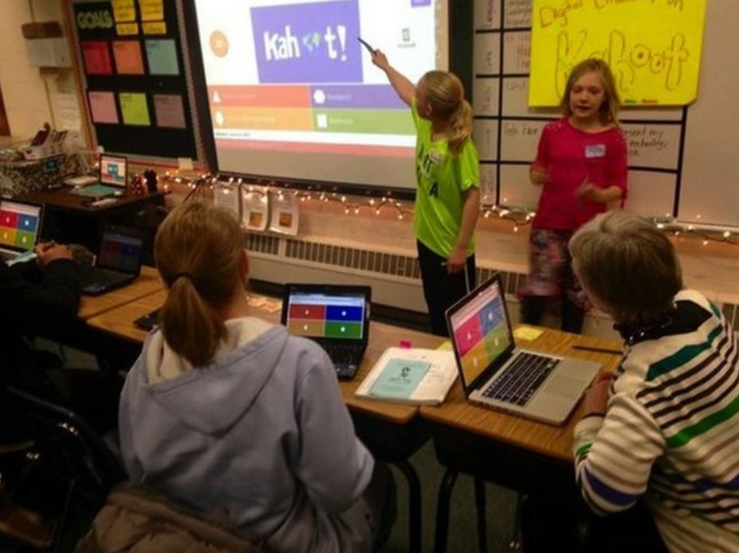
Relationship to Learning
Game based learning can be more engaging/ relatable
Learn while retaining knowledge
Pay more attention to game vs a typical quiz
Positive attention and focus in the classroom
Motivated to pay attention more adn to want to improve
Notes:
Students noted that the drive to increase their attention and interaction strongly supported their learning in the course

Slide 5
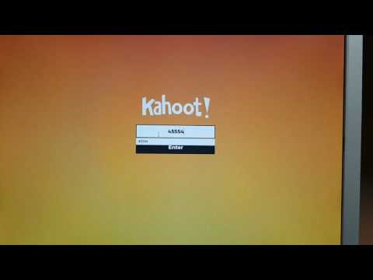
Notes:
This youtube video here gives you a look at what the teacher will see during a game vs what students see when they are participating. As an educator, it is important to test and see how the game will be used in your classroom environment and see if any changes need to made before you play it with your students.

Slide 6
PROS
Great way to recap learning
Make connections
Shows what students may or not be understanding yet, based off the classes answers
Can be motivational for some students due to competition
Motivated to practice/do homework on their own time so they can improve during class Kahoots!
Gives students a break in the lecture, meanwhile still learning the material in a fun and engaging way
Can be anonymous
Interaction between students
Notes:
There are many pros in using Kahoot in the classroom. Kahoot give students the opportunity to make connections with the material in many different ways. It could be at the end of a lesson to summarize what was taught, used as a fun engaging break activity in which students are still learning, or at the beginning of a lesson to refresh student’s brains. This can also be a form of competition, which can be motivating for some students. In a research study it was found that students were more motivated to practice/do homework on their own time in order to improve during class Kahoots! It was also concluded that students who were given breaks during lectures with Kahoots! Were more engaged and said the break was really helpful to their learning. The nice thing about Kahoot is that it can be anonymous so students are not forced to participate as there is also a time limit. It was also found in the research study that interaction between students and teacher increased during Kahoot activities.

Slide 7
Cons/Risks
Can cause anxiety for some students
Introducing competition into the classroom may bring out negative behaviours
Competition may get in the way of actual learning
Gamification elements/ Technology
Higher level grades (reading levels)
Notes:
Students who are more shy, or do not participate as much as others may experience anxiety from Kahoot! Research shows that Kahoot creates interaction with peers, which some students may not want to be involved in. There is also a timer to answer the question before, and a scoreboard which some students may feel anxious about. Introducing competition into the classroom may bring out negative behaviours, such as people being too competitive or putting down others for not participating how they may be. A student who was being interviewed explained that she enjoyed it, but thought towards the end everyone got a bit distracted with names and being competitive, and that she thinks sometimes you lose sight of trying to learn new things because you are just trying to win and have fun with friends instead of learning (Student 8). Another con would be using technology in the classroom and games, which families may not be okay with. As well as it being a form of technology, this game requires reading if a student wants to do it individually.

Slide 8
Strategies and Tips
Kahoot can be used as a break activity, a previous knowledge activity, a closing activity.
During lectures, telling students to really listen to the next part of the lesson as it may be a question on the Kahoot
Could make a ‘class goal’ for all total points of all students so all students receive a reward and work together
Let students create their own and explore Kahoots as it could be a good study method

Slide 9
Kahoot Strategies for in the classroom
Read out questions/choice of answers while playing the game so students who cannot read as fast are not behind
Give students more time to select an answer
Including “I don’t know” as a possible answer
Put students into teams so that there is less of a ‘winner’
Using Kahoot as a break activity during long lectures/lessons
Notes:
In using Kahoot in the classroom, I would read out the questions/ choice of answers for those students who are not as fast of readers as other students so they do not feel left out or behind. I would also give students a longer count-down to select an answer depending on the question or the group I am doing this with. I would also include a ‘ I dont know’ as a possible answer for students who are not sure instead of picking a wrong answer. I would also put students into teams so that there is less of a winner and competition variable. I would also highly recommend using Kahoot as a break activity during a long lesson as research shows students enjoyed it and appreciated the break.

Slide 10
Kahoot Time! (kahoot.it)
J
Join code will appear on the screen momentarily
Kahoot!
Notes:
Now we will be playing an example kahoot! This is from the kahoot academy, which has tons of pre-made games ready for anyone to use and lets you see all the questions and answers ahead of time, if you don’t have time to make your own.

Slide 11
Resources:
Find games of Kahoot! | Free learning games | Kahoot!
kahoot-logo-2.jpg (600×600) (teslontario.org)
How to launch a game of kahoot in Team Mode - YouTube
Collaboration in classroom with Kahoot! | Math teacher tips
(PDF) Students’ perception of Kahoot!’s influence on teaching and learning (researchgate.net)
How Motivation Affects Learning - The Inspired Classroom
(PDF) Students’ perception of Kahoot!’s influence on teaching and learning (researchgate.net)
Kahoot quiz example from instructor and student point of view - YouTube
'kahoot' in L'eVeille | Scoop.it

