Slide 1
Digital sketchbook
Alyssa Van stone
EDCI 307 Art in Elementary or Middle School Classroom
Dr Kathleen SChmalz

Slide 2
Table of contents

Slide 3
Child development
Stages of Children’s Art Development: Check your Misconceptions
Complete this handout as a group and go over together with your instructor:
1. At what age do children begin to draw their first symbolic art work (the
'Ghostly’ person)? 4 years
2. Are all Kindergarten children past the scribbling stage of art? no
3. At what age does the average child first create full story-drawings? Around 6-7 – this coincides with the strong narrative push that we capitalize on to teach children to read.
4. Is art work an accurate indicator of intelligence in children? no
5. Is it good educational practice to have children colour adult drawings?-
Educational research has revealed several problems with colouring adult drawings: first primarily visual learners who enjoy a beautiful surface will enjoy this activity while others will not. Secondly, it has been shown that children often do not even know what some of the adult images are so there is not a lot of thinking going on as opposed to the children’s own drawings influenced by experience, observation and discussion
6. How does drawing style relate to learning style?-----------------------------
different learners will take to different materials – e.g. visual learners may hate finger painting as they think it is ‘yucky’ where tactual learners will glory in the sensuality of the experience. It will also affect speed of working as Kinesthetic learners will often work very quickly while tactual learners must get a feeling before they can even start.
7. What developmental drawing age are most North American Adults?
According to Betty Edwards in Drawing on the Right Side of the Brain, the average N.A. adult is at about a grade 4 level in art. The reason she states is lack of focus and interest in art on the part of our educational system
Scribbling Stage Ages 2-4
Pre-schematic Stage Ages 4-6
Schematic Stage Ages: 6-9
Gang Age: Ages 8-12
Dawning Realism: Ages 12-14
8 What are the advantages of exploring Stage theories? What are the disadvantages? Advantages: help make sure teacher expectations are not unfair or unrealistic.
Disadvantages: each child needs to be seen where they are at right now regardless of the stage. Some teachers may use stages as a way of discriminating against slower developers or ignoring quicker developers.

Slide 4
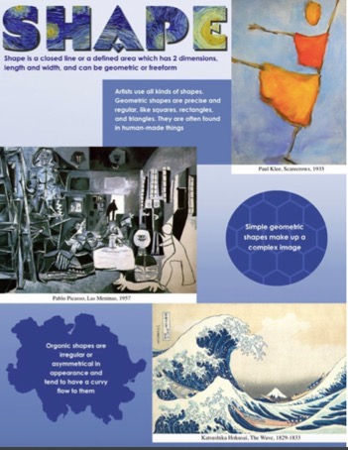
Element of shape
Organic Shapes
Geometric Shapes
https://www.youtube.com/watch?v=bJzGkZwkHt4

Slide 5
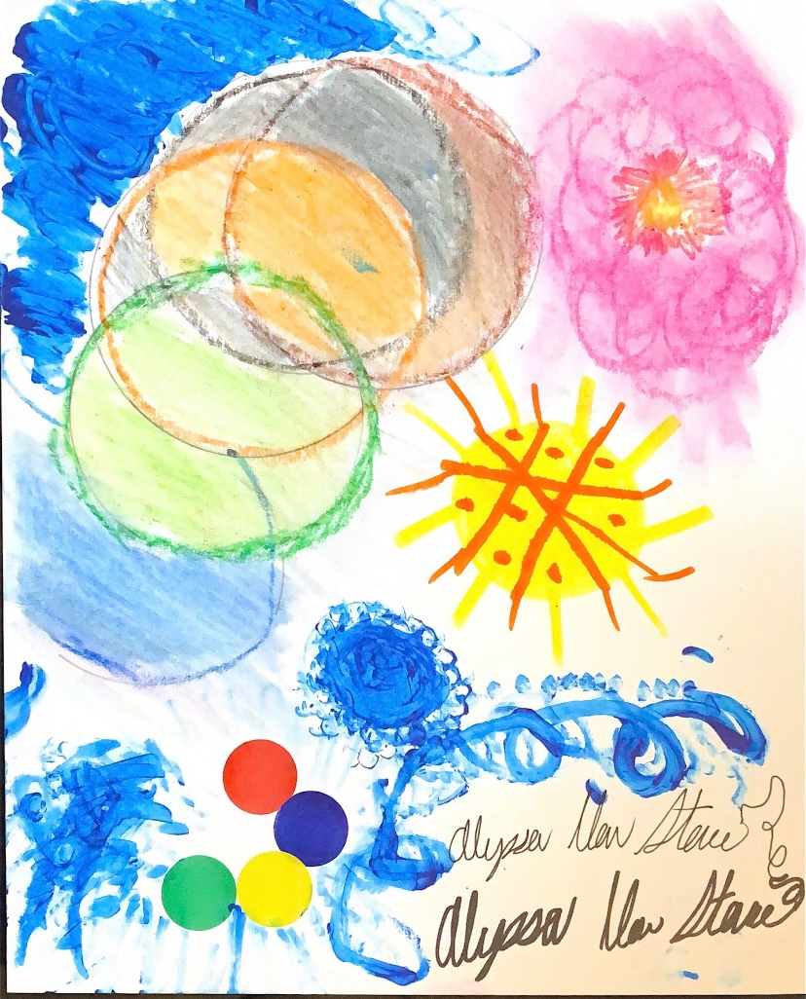
Elements of shape: dot experiment
The purpose of this activity is to get students to explore the materials, using dots of any size of colour, using different materials.
Materials used: markers, crayons, water colour, paint, stickers, oil pastels, sharpies, heavy paper, pencil, and a compass.

Slide 6
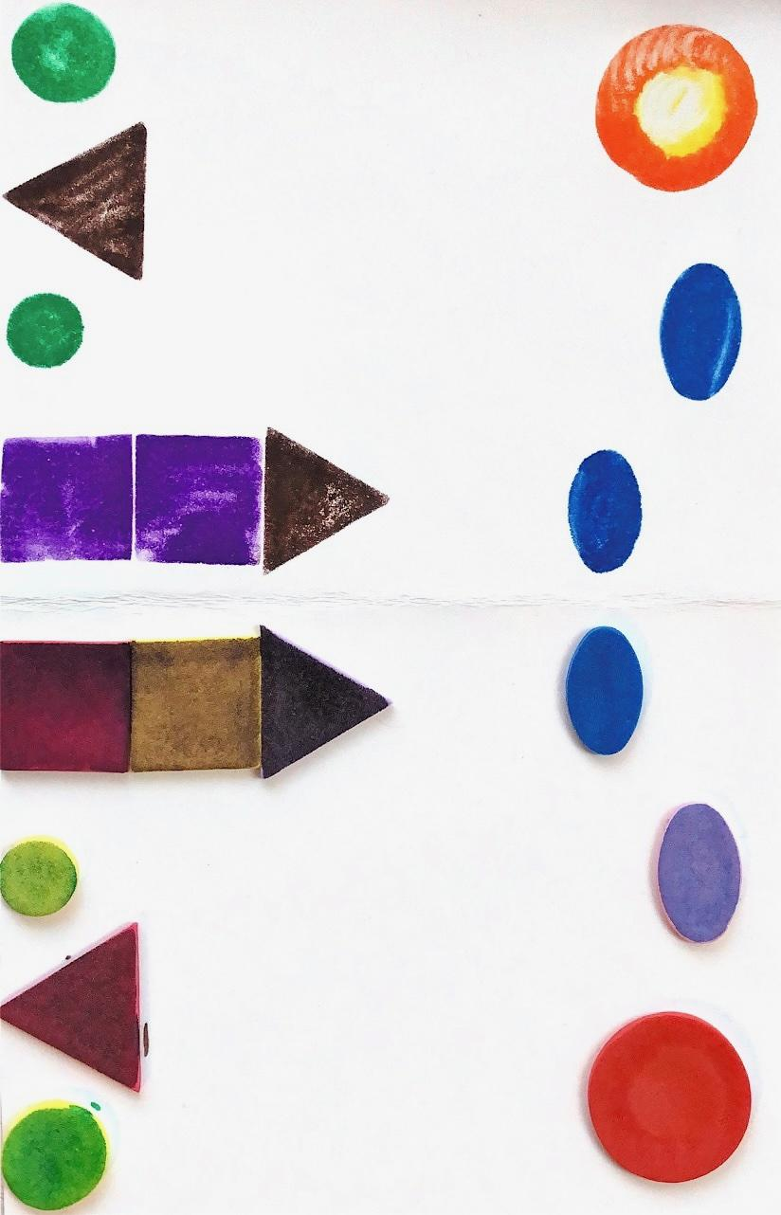
Element of shape: Foam activity
An activity that shows students how to combine geometric shapes to make complex shapes/pictures. This works by colouring with marker on the stickers, a fair amount, and folding the paper to create the image on the side. A fun way to learn about shapes and patterns, and how shapes can create more complex art.
Materials: foam stickers, crayola felt pens, ½ piece of water-colour folded in half.

Slide 7
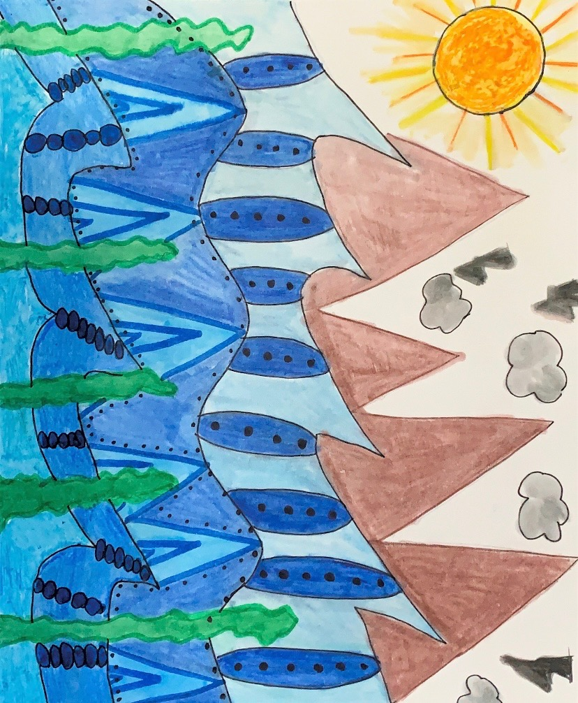
Elements of shapes: shape activity
Using the element of shape, organic and geometric shapes, experiment a shape inspired art piece.
Materials: Q-tip, watercolour pencil crayons, paint, oil pastels, crayons, round stickers, pencil, compass, heavy paper.

Slide 8
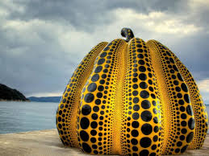
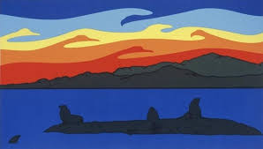
Element of shape: artists
Roy Henry Vickers “ A Lot of Bull”
Using simple shapes and colours to create a powerful piece. rver. The paintings and works that he has created reflect this mixed heritage as his
work has many elements of the traditional art of the First Nations peoples of the Pacific Northwest, but
keeps its own distinctive character.
Yayoi Kusama “Naoshima Pumpkin”.
Using circles to create a more complex shape.
She has continued to work while living in a home for people with emotional challenges. She is very open about her health challenges and yet has continued to be a world famous artist
Notes:
https://www.youtube.com/watch?v=an0g93vw5j8&feature=emb_logo - the museum of Yayoi Kusama
https://www.youtube.com/watch?v=Z4OhwL7WyHg&feature=emb_logo - Kids Critique
https://www.youtube.com/watch?v=xCtgpKTXzWo&feature=emb_logo : Humpback song
All videos that could be incorporated into the lesson.

Slide 9
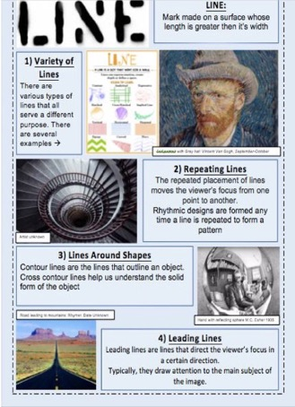
Elements of line
There are various types of lines that all serve different purposes.
Line: a mark made on a surface whose length is greater than its width
Repeating lines: repeated placement of lines moves the viewers focus from one point to another.
Lines Around Shapes: contour lines are lines that outline an object. This helps us understand the solid form of the object.
Leading Lines: that direct viewers focus in a certain direction. Typically, draw attention to the main object.
https://www.youtube.com/watch?v=BDePyEFT1gQ

Slide 10
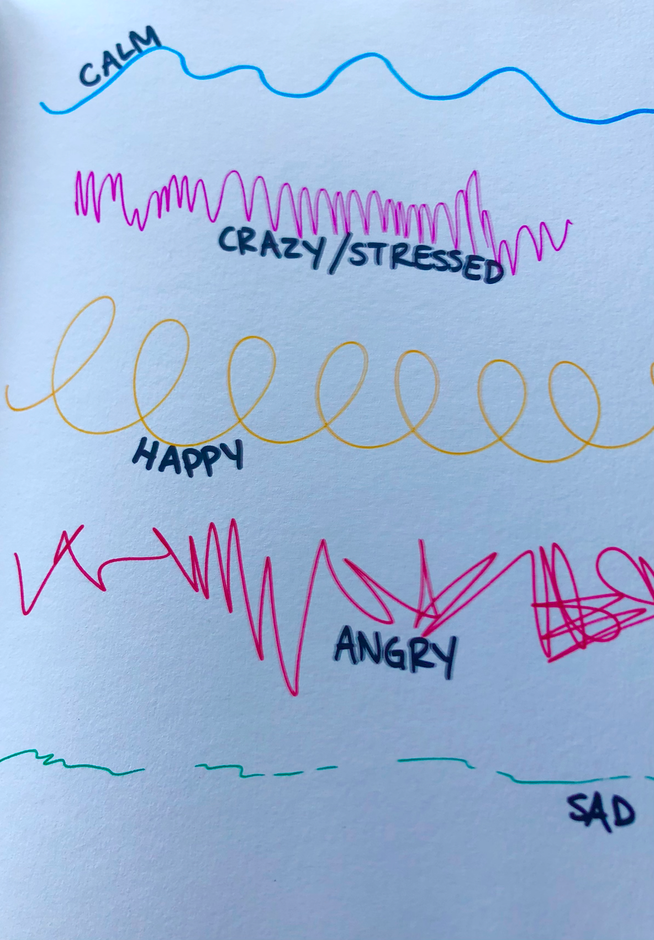
Elements of Line: Lines have feelings
Students will draw lines on paper with crayon to accompany a 2-3 minute disney overtune or other music that incorporates changes of tempo and instruments.
Name the lines with emotions.

Slide 11
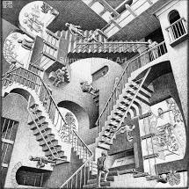
Mentor Artist - m.c. escher
As a task, get the students to critically analyze this. Look at the details, the shapes, the colours, the lines, the light, etc.
This piece is done with pencil or pen.

Slide 12
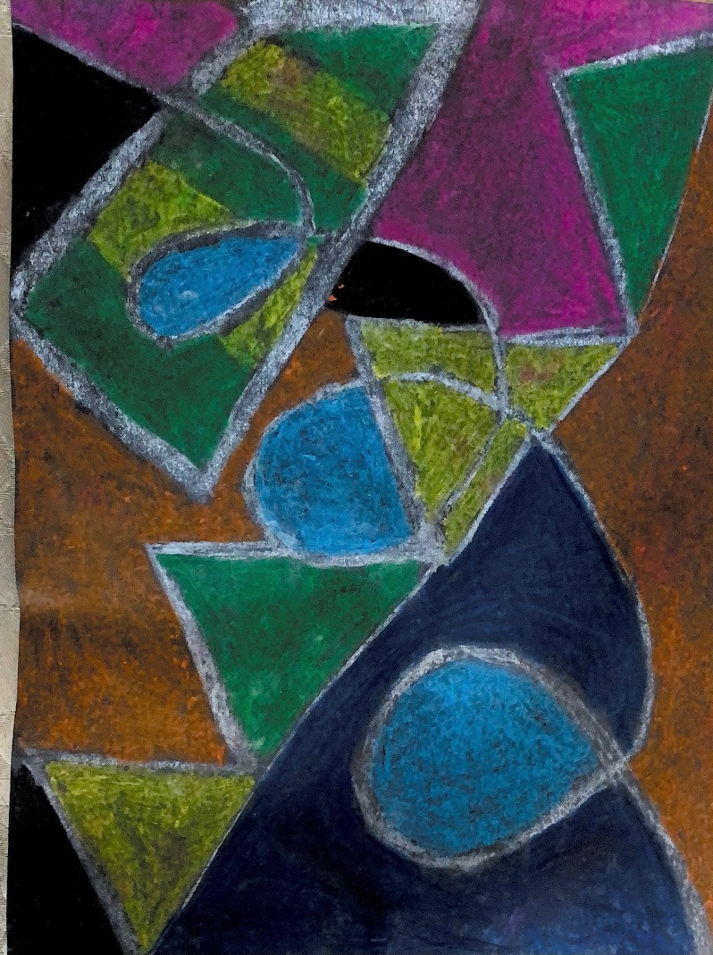
Elements of line: Chalk/Pastel Batik experiment
Using at least 3 types of lines (zig zag, swirling, horizontal, vertical, dotted, widening, narrowing) vary the thickness of these lines to show emotion. Students can guess what feeling they are trying to portray with what lines and colours used.
After the chalk lines, add colour to the spaces between or however you would like. Add water to gently wipe off the chalk. This may need to be washed more than once
(photo was only washed once, could have used more to get rid of the white but I liked it)
Materials: construction paper, chalk, pastels, water

Slide 13
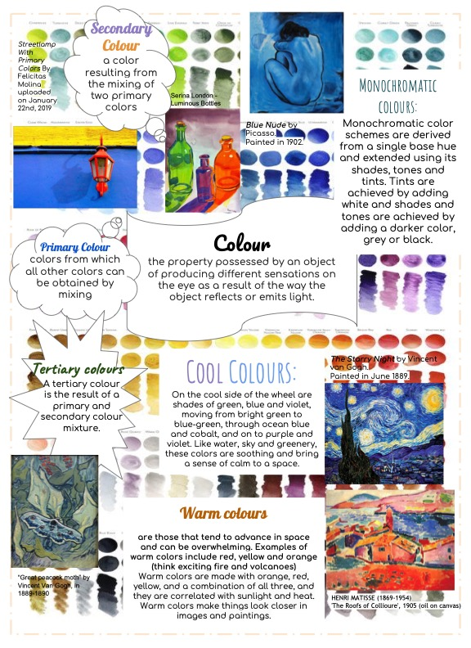
Element of colour
Colour: the property possessed by an object of producing different sensations on the eye as a result of the way the object reflects or emits light.
Primary colours, secondary colours, tertiary colours, cool colours, monochromatic colours, and warm colours.
https://www.youtube.com/watch?v=wWW_UbrkBEw

Slide 14
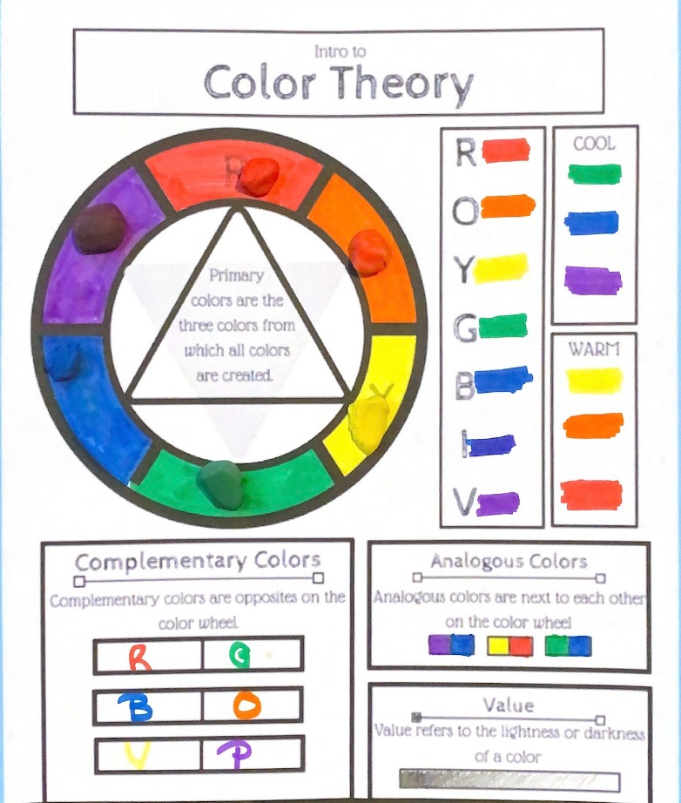
INtro to color theory
This is a great way to get students to understand colours and how they mix together to make different colours. To check for understanding, get the students to play with clay to create the colours on the colour wheel.
Materials: clay, markers, pencil, handout

Slide 15
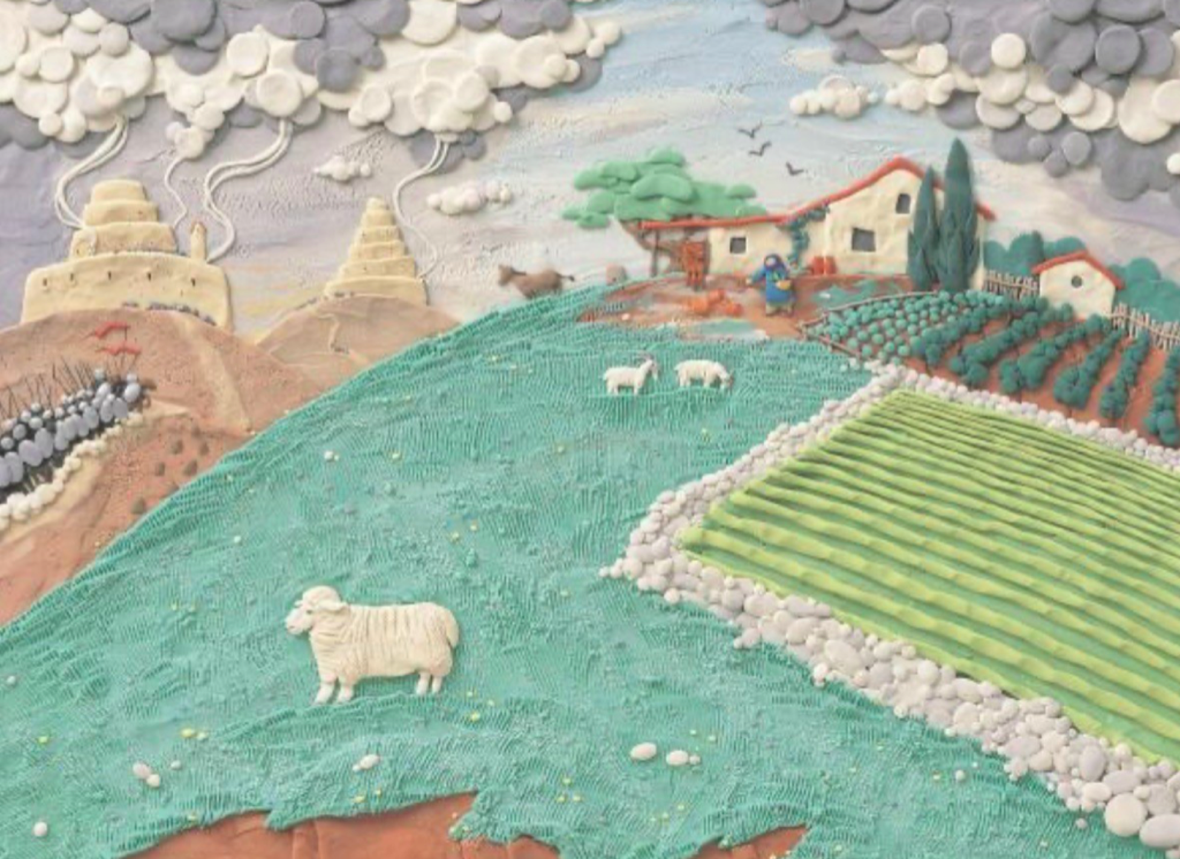
Artist spotlight : Barbara reid
Children’s picture book author and illustrator
Award winning, Canadian trained artist
Involved in Canadian schools and literacy programs.

Slide 16
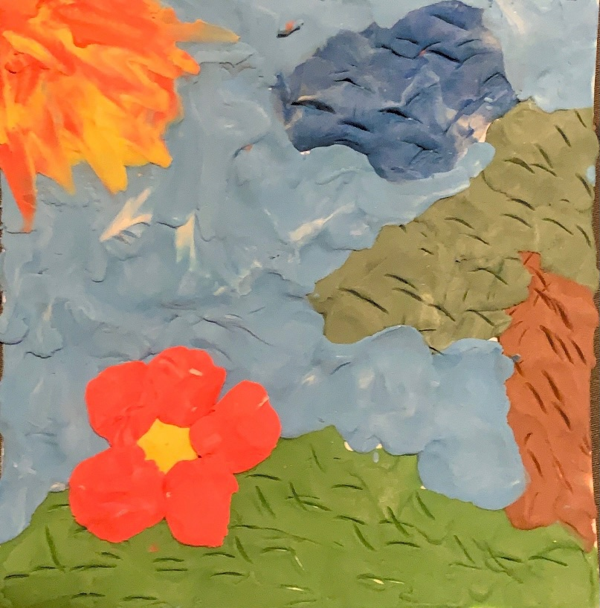
the plastercine relief activity
Creating a plastercine relief in the style of Barbara Reif using one schemed tinted with white, and shaded with grey.
Mix Tertiary colours (a secondary colour and primary colour) tint with white and shade with grey.
Discuss feelings of colour scheme.
Materials: clay, heavy paper.

Slide 17
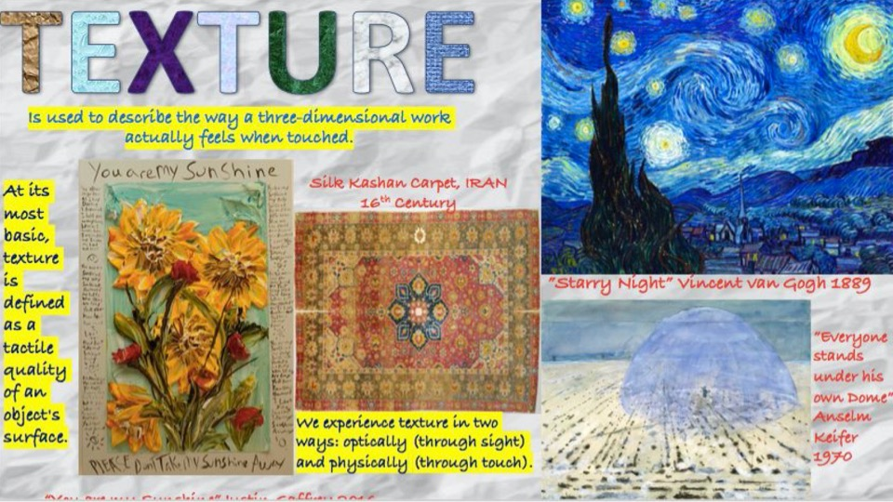
Element of texture
Concepts: texture can add emotion to an art work
Textures can be real: you could feel them with your hand
Textures can be implied: they look like you could touch them but they are flat.
https://www.youtube.com/watch?v=YoOb3JSDAUo

Slide 18
Element of Form
Form refers to either 3D added to shapes to create actual forms or the illusion of form created through value or diminishing detail.
Forms can be geometric and/or organic shapes.
https://www.youtube.com/watch?v=9DIPs3T2dQk

Slide 19
Element of value
Value is the visible light or darkness of a colour of tone.
https://www.youtube.com/watch?v=AAwYHNo31ZQ

Slide 20
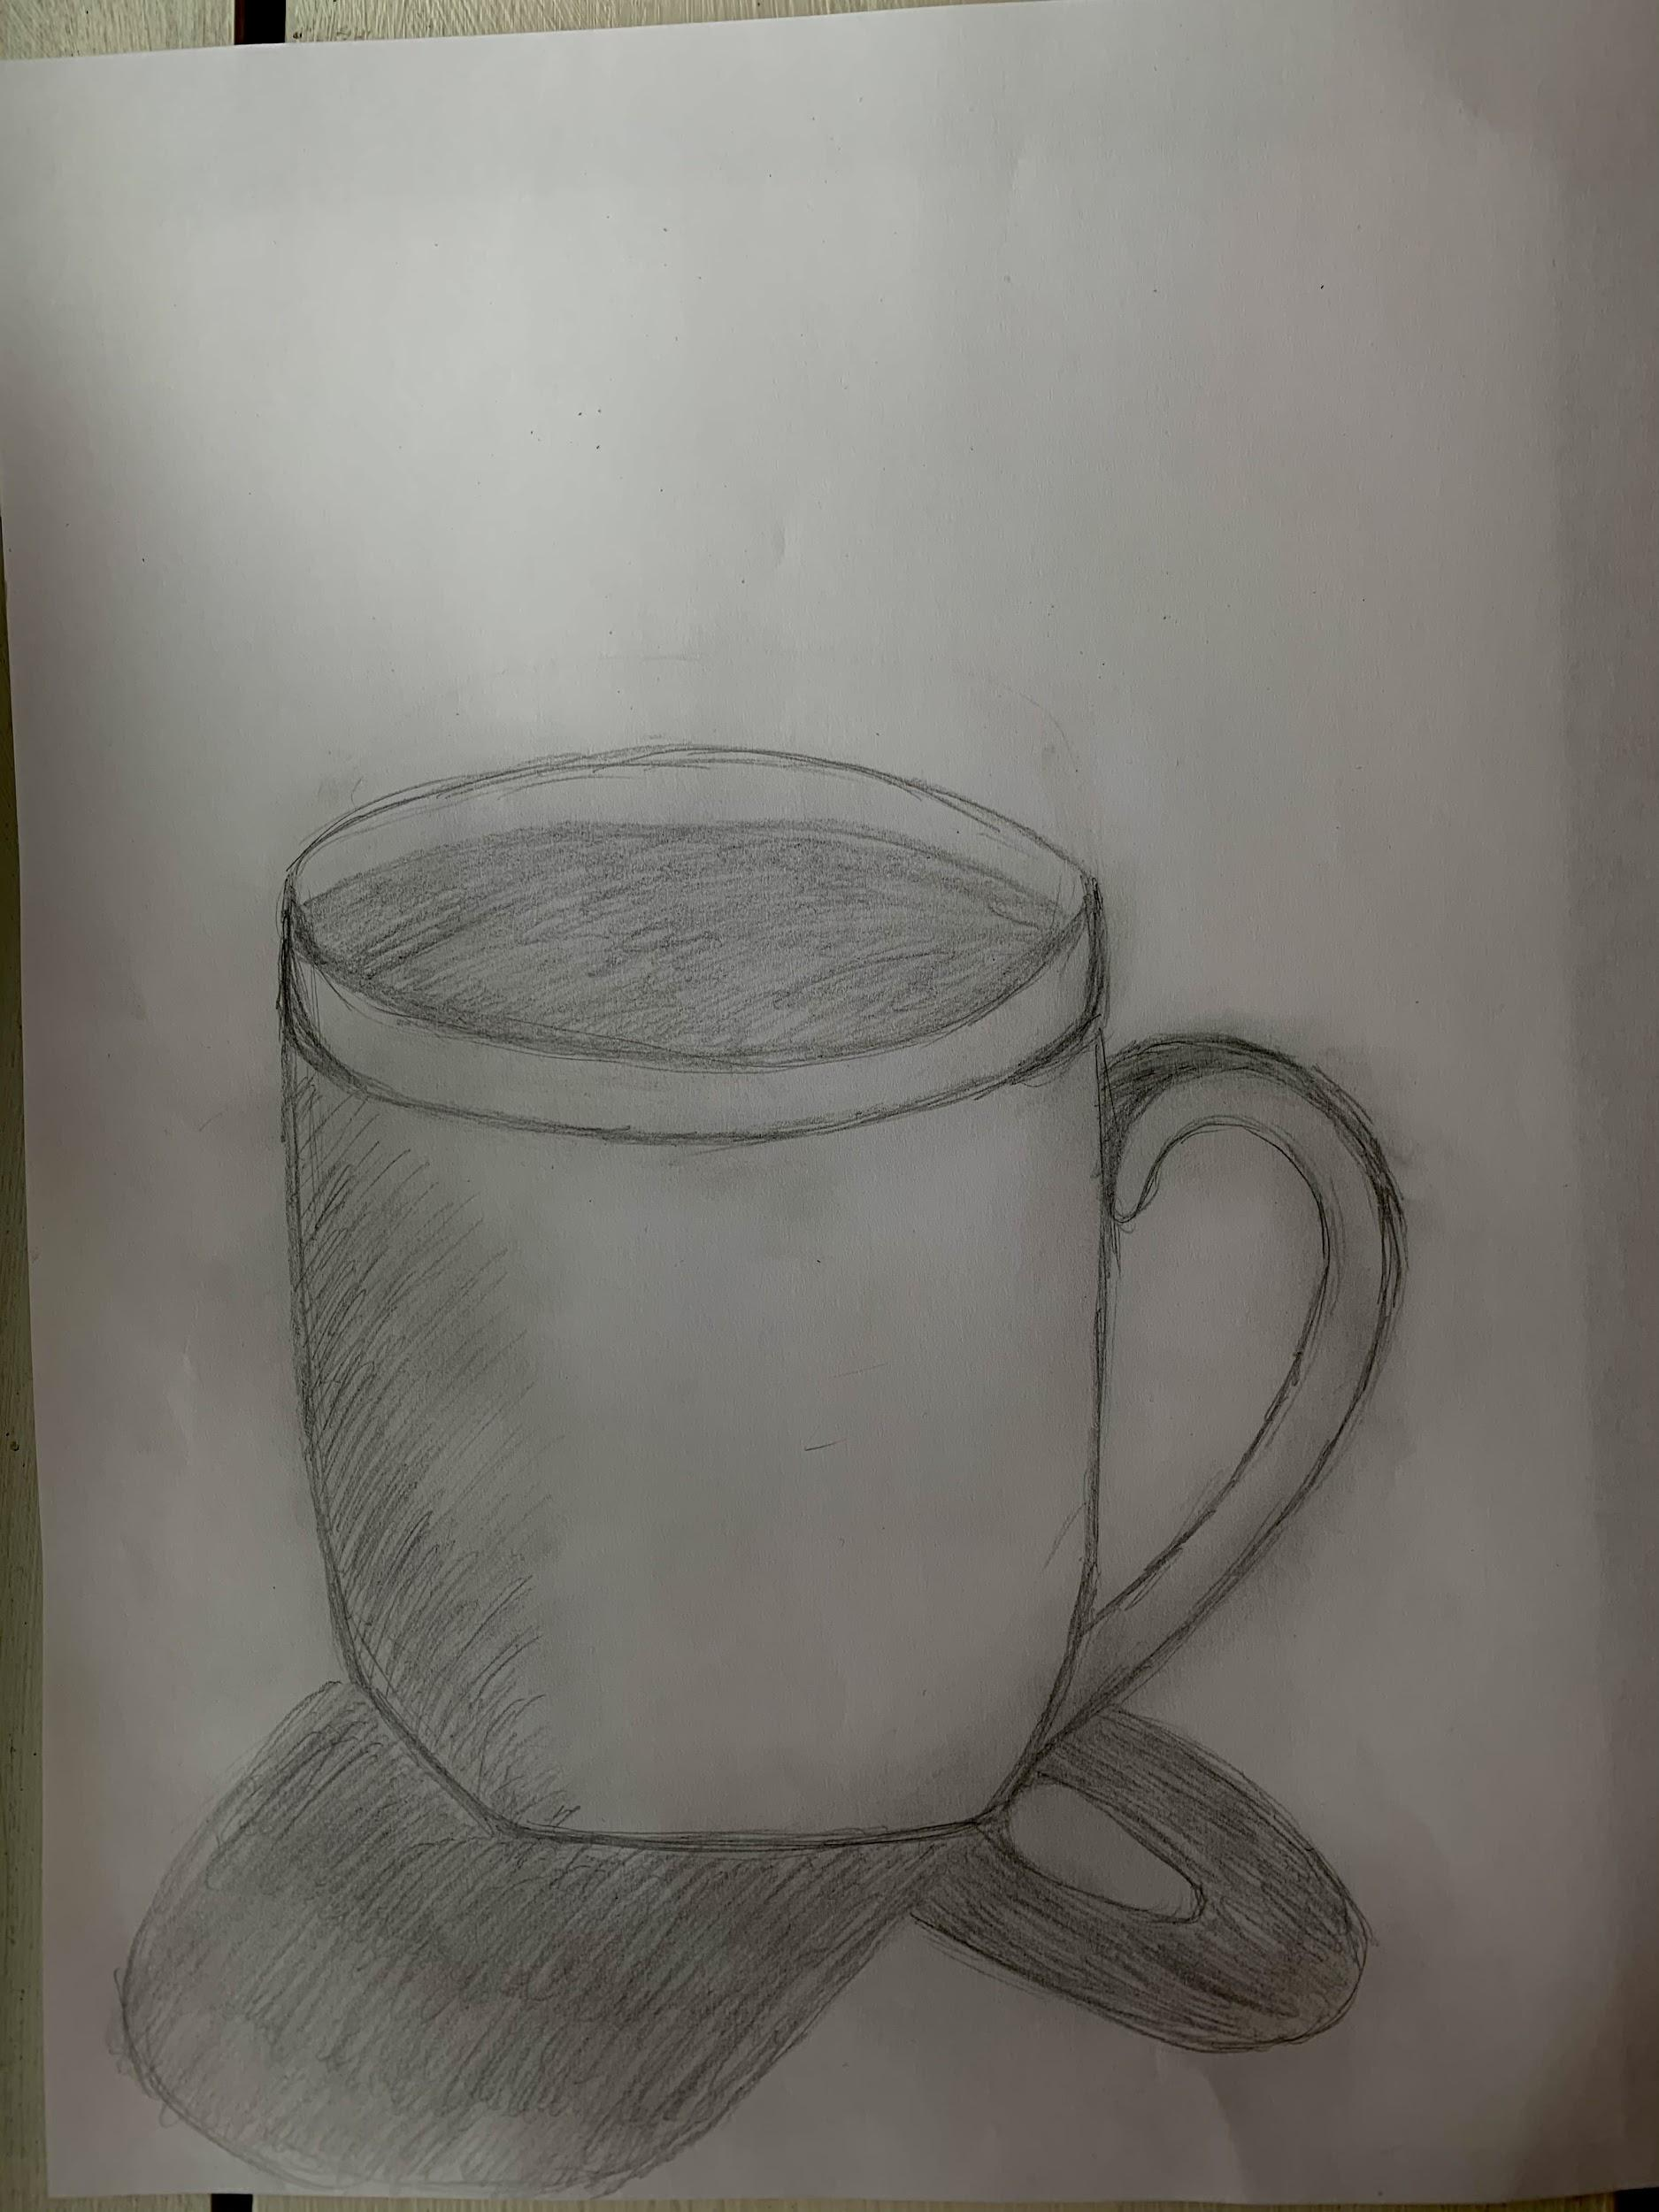
White object activity
Find a white or coloured object.
Place object where there is only light source possible. (may need to turn off the lights and place it near a single lamp). We will look at the lights and darks and minimize the use of lines.
Materials: heavy paper, pencil, eraser.

Slide 21
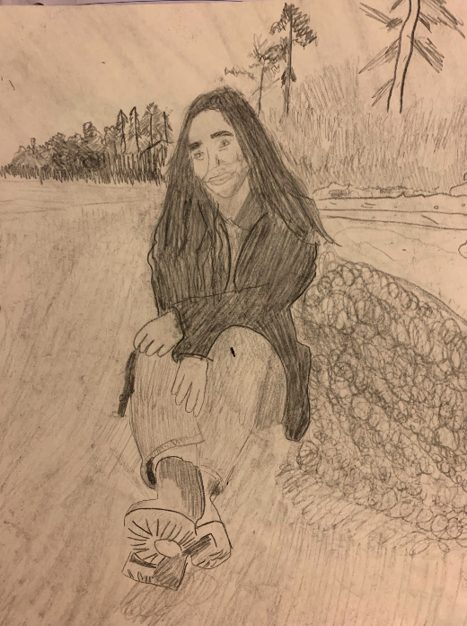
Carbon paper activity
Print out an action shot picture of yourself, or a picture that is meaningful to you. Print this picture out in black and white. Make sure the background is not too difficult to draw, such as crashing waves, bushy trees, many people. Decide what part of the drawing you will draw. Take a piece of water-colour paper, then a piece of carbon paper and put the black side facing down on the water colour paper, then put the black and white picture of yourself on top of both. Then tape it at the top so it wont move. Gently trace on the paper what you want on the white paper. Make sure you are being gentle. You may also want to use an eraser to do some shading.

Slide 22
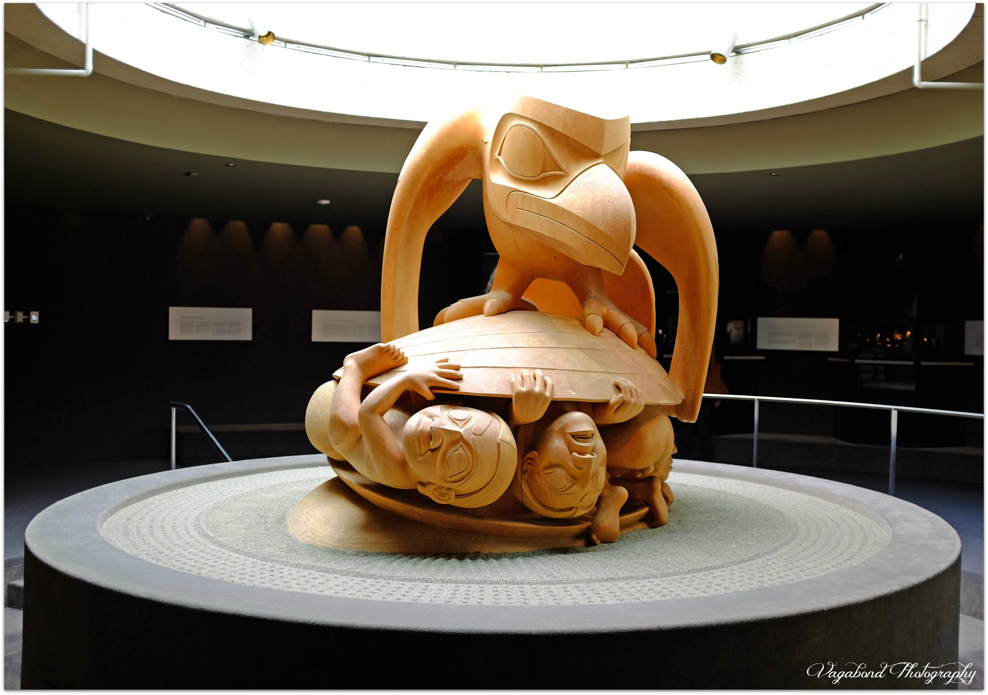
Critical analysis: Bill reid
Indigenous Haida artist
Uses this piece to tell the Haida story of creation.

Slide 23
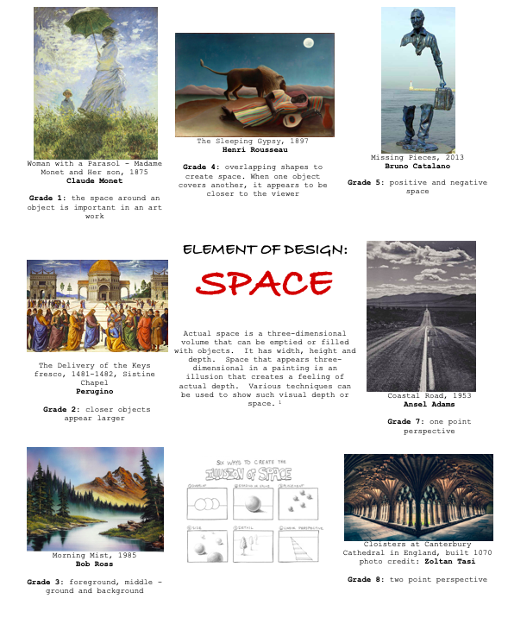
Element of space
Actual space is a three-dimensional volume that can be emptied or filled with objects. It has width, height, and depth. Space that appears three-dimensional in a painting is an illusion that creates a feeling of actual depth. Various techniques can be used to show such visual depth of space.
https://www.youtube.com/watch?v=U11B_0FCn6o

Slide 24
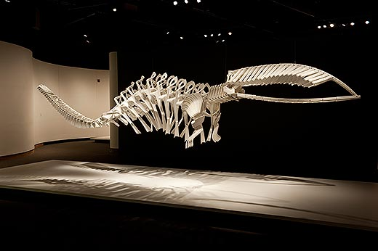
Artist spotlight: Brian jungen
Indigenous Haida artist
Uses everyday objects to create significance as he explores Indigenous ideas.

Slide 25
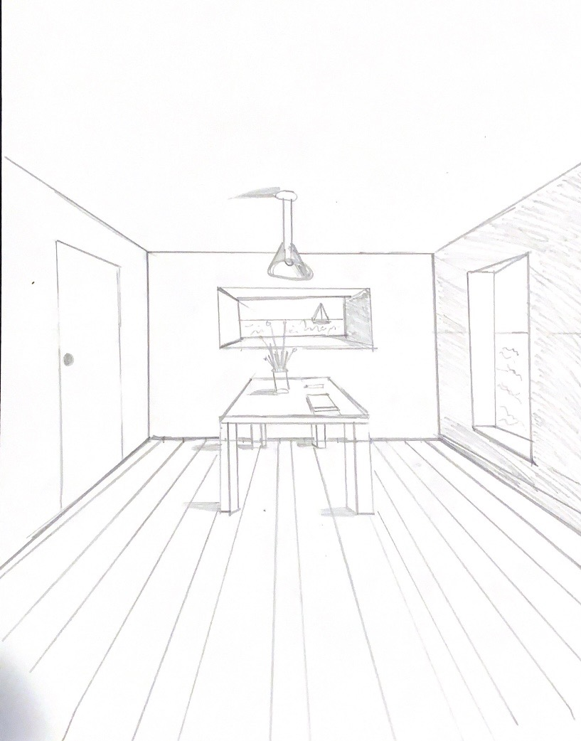
One point perspective
Two parallel lines going towards vanishing points will look like they meet at the vanishing point; the vanishing point is always on the horizon line.
https://www.youtube.com/watch?v=qOojGBEsWQw a video tutorial on one point perspective ( a room)

Slide 26
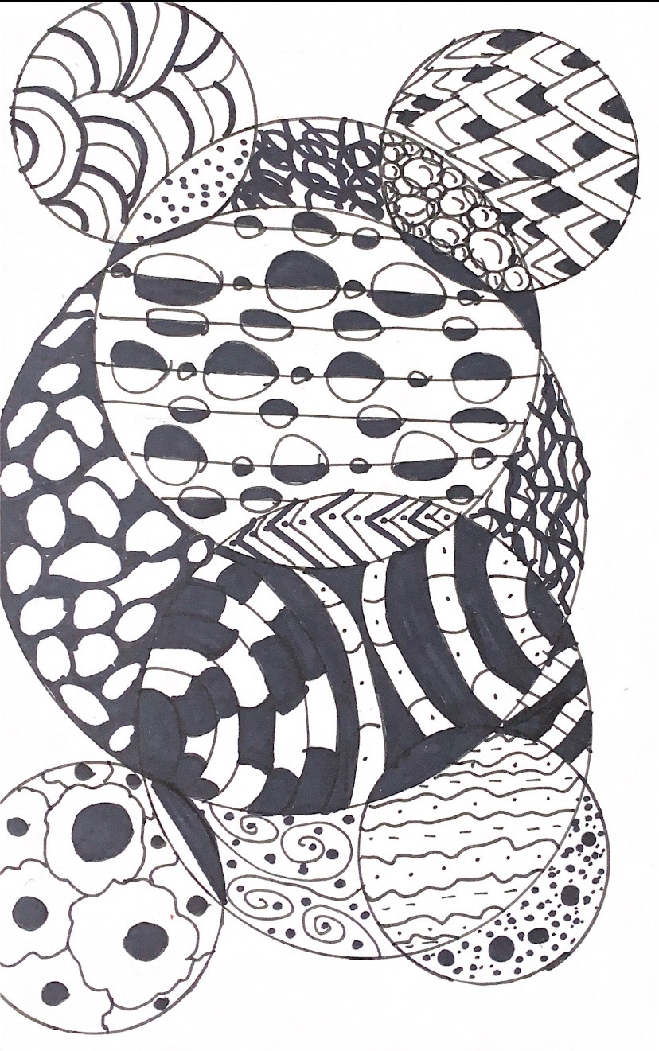
Image development strategies - zentangle
Get students to watch a youtube video on zentangles. Draw 3 circles with a protractor and create patterns. Key parts to this is: symmetry, different weights of line, spaces split into smaller spaces, and black spaces.
Materials: 2 sizes of black felts, protractor, pencil, paper (pencil crayons if you want colour)

Slide 27
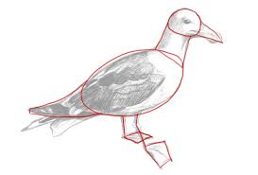
simplification
Think of an animal you want to draw, on a half piece of paper, draw it from your imagination.
Google “fair use” and find a photograph of an animal, print this in black and white
Use crayola felt pens to search out and draw geometric shapes as you see them.
Now looking at your picture with shapes, draw this animal o the other side of your paper starting with drawing shapes first
Leave the shapes visible on your final drawing so we can see how simplification helped.

Slide 28
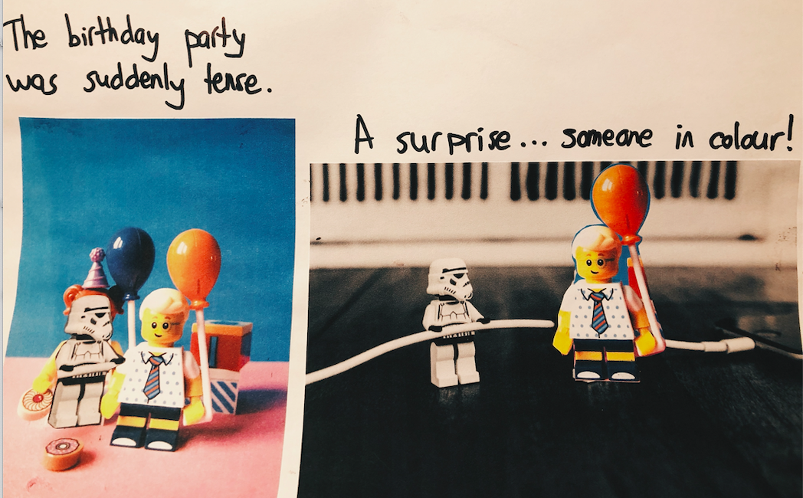
substitution
Look at 2 images,and think about attributes of one and then the other. These could be personality, visual, experience, colour, shape
Print images, and use sharpie felt, pen, scissors and add something on the butterfly from the woman and something on the woman from the butterfly.
Write two sentences about the idea.

Slide 29
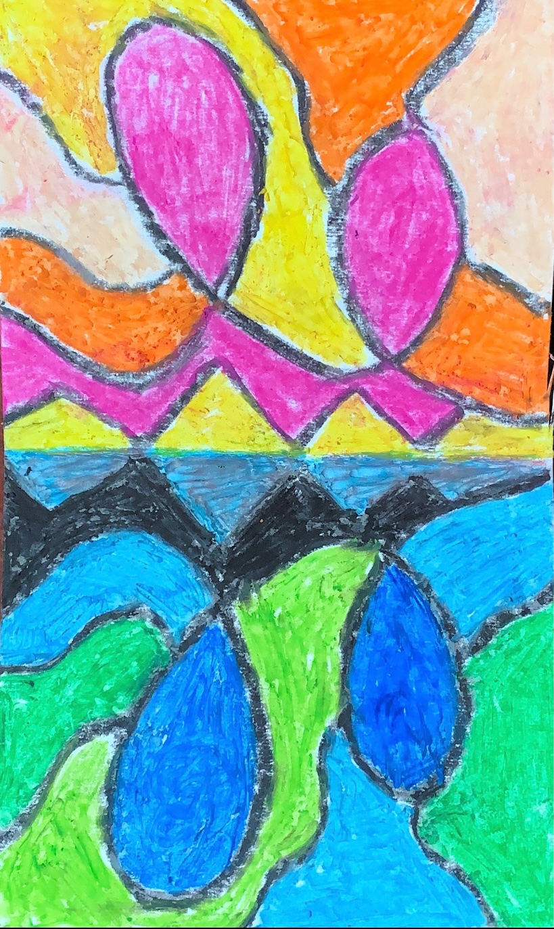
reversal
Cut a sheet of heavier paper in half. Fold that piece in half. Open it up and on one side, draw a simple pattern or picture in black oil pastel. Re-fold. Press firmly on the back of the paper with a back of a spoon until you have transferred the image to the other side. Use the black pastel to firm up drawing. Now choose different colour combinations for each side (warm on one side, cool on the other, or complementary colors on each side)

Slide 30
Rubbing collages
Fold a piece of photocopy paper in half, cut off the top half for doing the rubbings. Fold the bottom park in half
Use your finger to find textures that you can feel (real textures) Put your paper over the top and use a crayon to rub over the top to make a picture of the texture. (implied texture) Make each section of rubbings big enough that you can cut out some of the textures.
Cut out textures to make a similar picture or pattern, or an abstract if you prepare. Glue it into the half of the remaining paper.
Now use pencil and very lightly draw in the shapes you see on the remaining paper. Use the pencil to draw in the textures. Don’t be afraid to go very dark where they are dark.

Slide 31
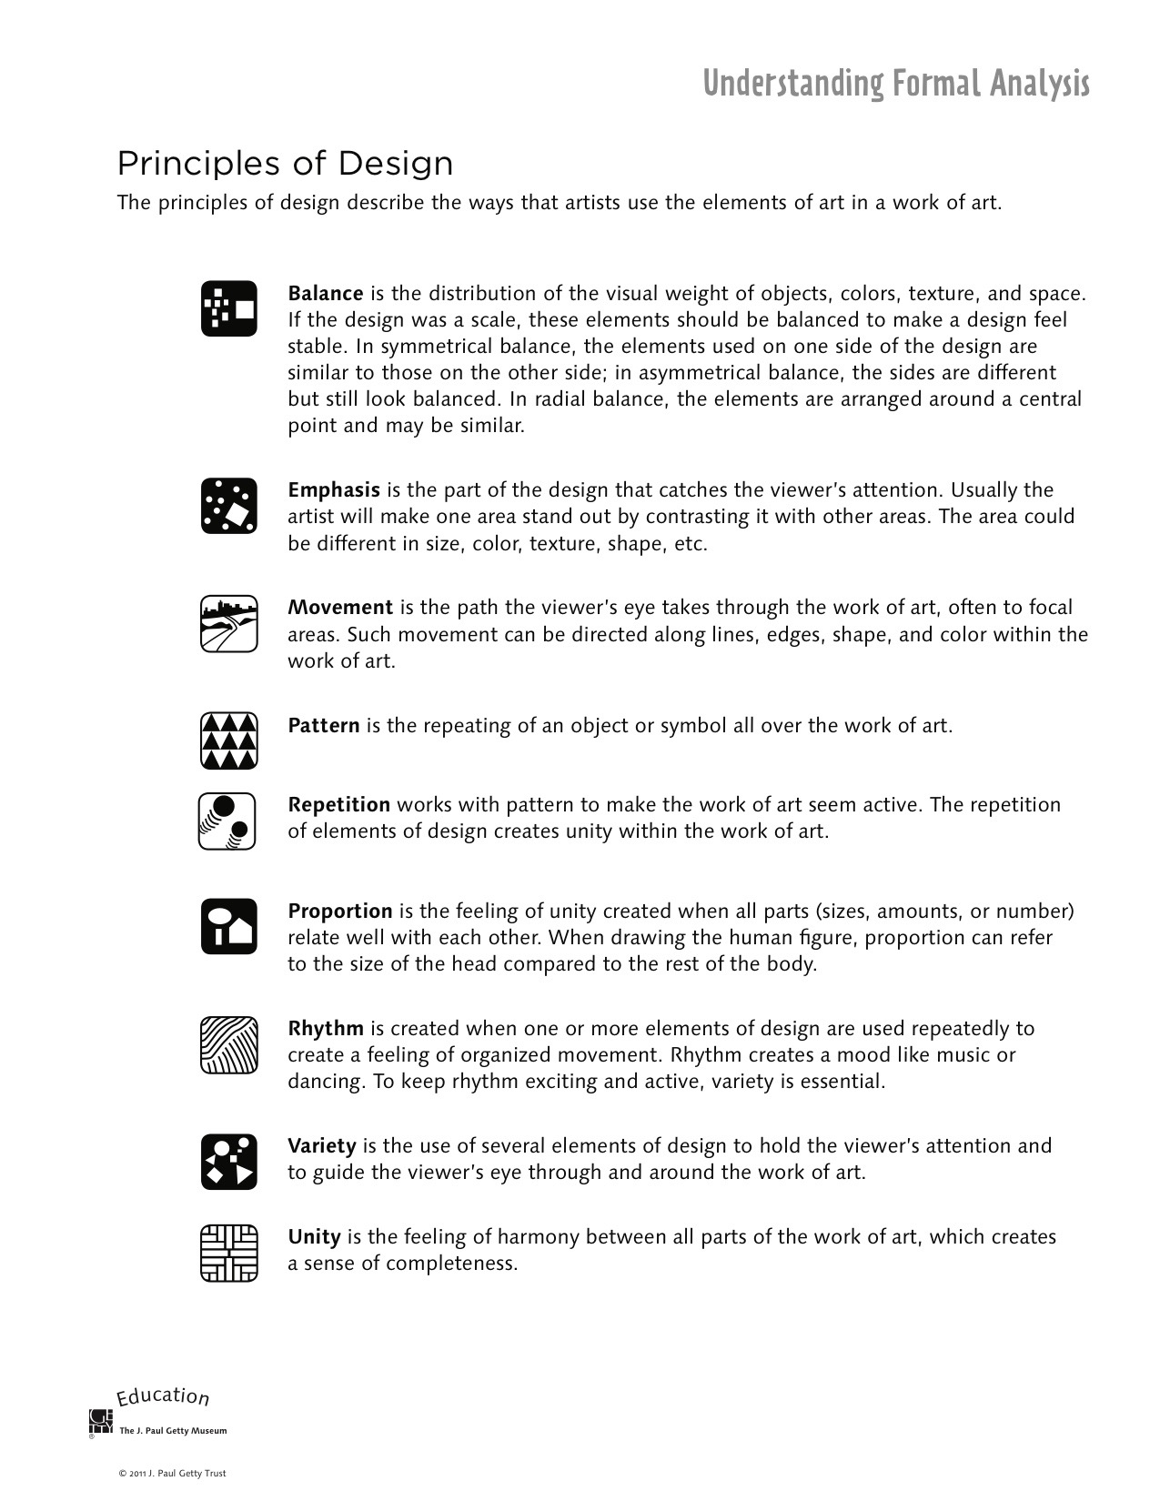
Principles of design

Slide 32
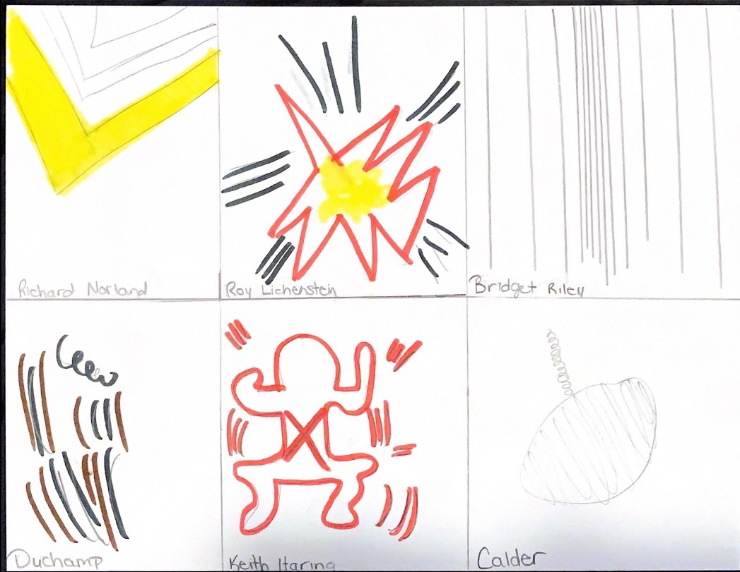
Discovery movement activity
Give students 6 images. Ask them to draw where the image catches their eye, the part of the art that is moving.
Put artist name underneath.
Add colour to make the part that catches your eye pop.

Slide 33
Critical analysis: norval morrisseau

Slide 34
Critical analysis: kent monkma

Slide 35
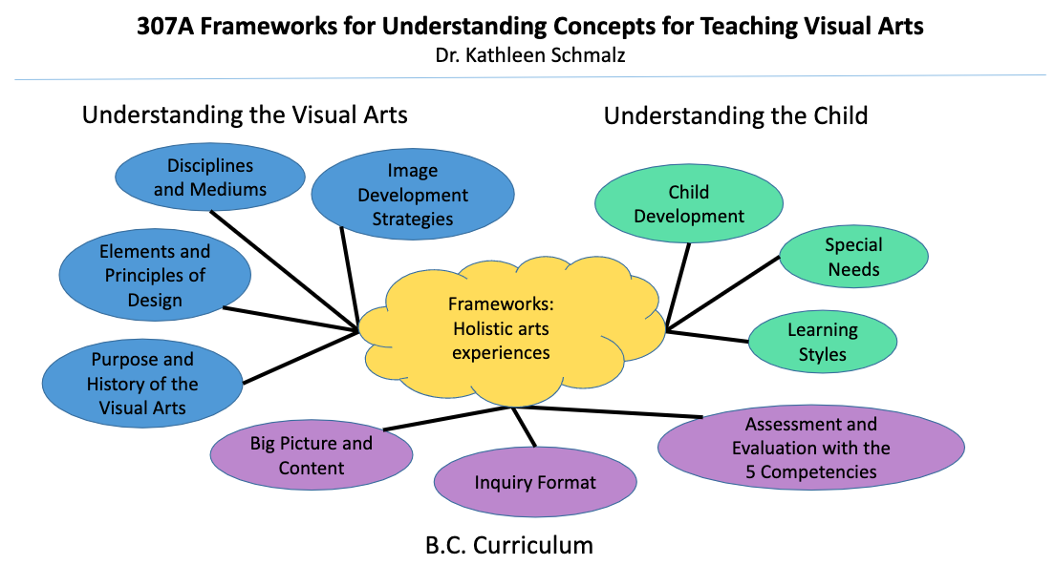
British columbia art curriculum

Slide 36
Example of grade 7 unit plan
https://docs.google.com/document/d/1ZaywQm4KVFS15RfhDfgKZSgVAWVIFM4p2PAxV830FI4/edit?usp=sharing
Lesson Plan on Line and Movement

