Slide 1
How does physical activity affect sleep?
Anna, Alyssa, Emily - EPHE 311

Slide 2
INTRODUCTION
Physical Activity has many health benefits that help scaffold a longer, healthier lifestyle.
Physical activity also benefits people’s sleep schedules as it directly relates to the increase in the quality and duration of a good night's rest.

Slide 3
Sleep is important
Approximately 80% of US adults and adolescents are insufficiently active. Physical activity fosters normal growth and development and can make people feel, function, and sleep better and reduce risk of many chronic diseases.
It is said that adults should be exercising at least 30 minutes per day, 5 days a week
Experts also say that obtaining 7 hours of sleep aids in muscle growth and repair, therefore promoting physical activity.
We can foster the relationship between physical activity and sleep in many different ways..

Slide 4
When should we exercise?
Ever heard of the expression “do not exercise before bed, you won’t be able to sleep!”
Evening exercise can actually lead to better quality of sleep, as long as that exercise occurs 90 minutes before bedtime.
With this being said, exercising in the morning is noticeably the best for sleep quality. Exercising in the morning can provide energy boosts to start and fuel the day by providing endorphins, therefore as the day goes on you will be more tired by bedtime.
As well as exercising in the morning, exercising outdoors can help align our circadian rhythm with sunlight. When our circadian rhythm is in sync with natural light, we tend to be more alert in the day and more tired at night.

Slide 5
Exercises we can do before bed to enhance sleep
Low intensity exercises: without increasing heart rate & body temperature
Research shows that doing low intensity exercises before bedtime can enhance our sleep.
This may include: pilates, yoga, self massage, stretching, relaxation exercises, and meditating.

Slide 6
Breathing exercise
Diaphragmatic Breathing:
Diaphragmatic breathing creates negative pressure in the space in the lining of the lungs. When this pressure is negative, it increases blood flow to the heart, decreasing your heart rate and helping you feel calm and relaxed.
Step 1: focus on your belly. It may help to put a hand on your belly so you can feel it rise and fall.
Step 2: Take a deep breath and hold it for 6 seconds before releasing slowly. (imagine air filling in your abdomen, then travel out of your airways)
Step 3: Slowly repeat. (continue this pattern for 5-10 minutes or however long it takes you to feel relaxed and ready for sleep)
Notes:
Ask if they are feeling more relaxed and calm after
Ask if they know any other breathing exercises to do before bed that helps them relax?

Slide 7
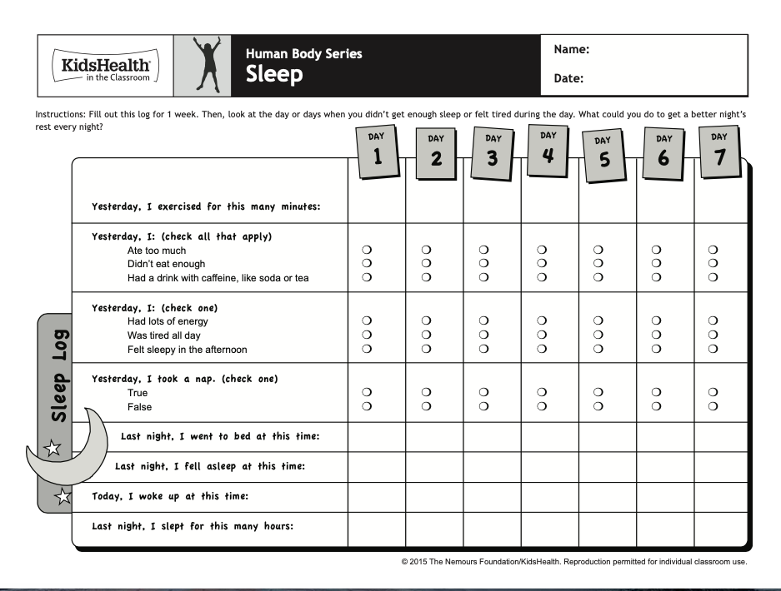
Ways of integrating sleep education into the classroom

Slide 8
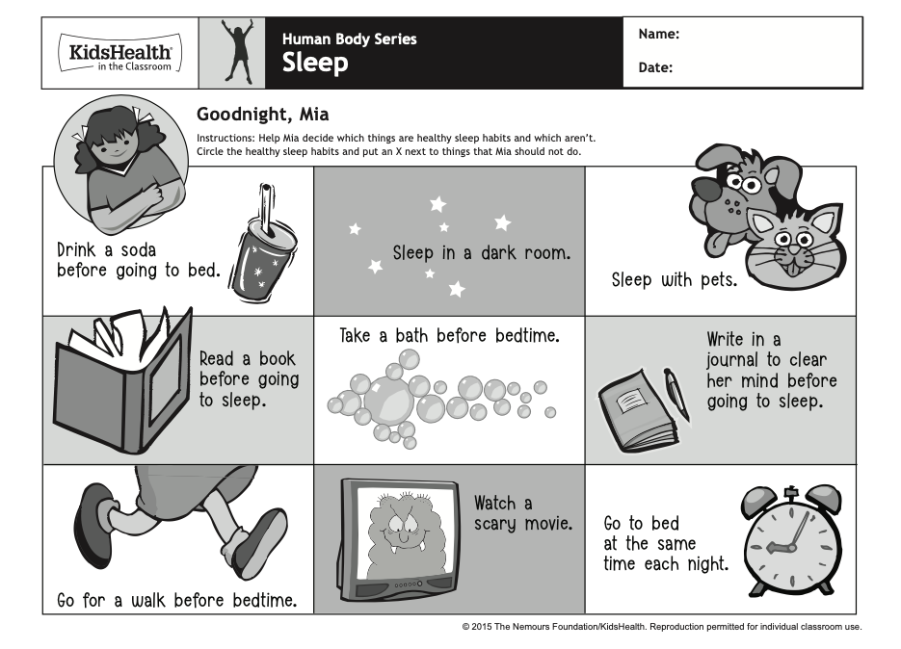
Get the students thinking about Their own habits!

Slide 9
Sleep and Current events
Covid-19 has impacted everyone’s lives, sleep and physical activity included
How has your sleep schedule changed in comparison to before the pandemic?
Studies have shown that sleep duration has increased yet quality has decreased
Why is this?
Huge restrictions on going out individually
Stress and anxiety levels are through the roof
All of this is correlated with a healthy well-being

Slide 10
Other Resources for students and Teachers
http://adventuresofpatoo.herokuapp.com/
https://www.participaction.com/en-ca/benefits-and-guidelines/adults-18-to-64
https://www.participaction.com/en-ca/everything-better/sleep-better
Notes:
- Each of these resources are a huge help for both educators and students
-Adventures of patoo is a engaging comic where students can choose different outcomes
- the second is guidelines from participaction that are recommendations from 18-64 year olds
-the third show the benefits of a well rested sleep and what you can do to help get a better night’s sleep

