Slide 1
Promoting Healthy Relationships Within the Classroom
By: Alyssa Van Stone

Slide 2
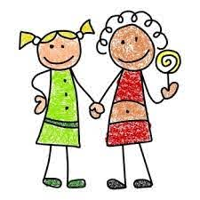
My In quiry
My inquiry is linked to the core competency collaboration and community engagement: to ensure and develop positive and supportive connections with the students.
My wednesday school visits inspired me to look deeper into classroom relationships. On the first day I was there, I noticed how well behaved and respectful the students were to each other and the teacher.
I then decided to explore this topic to ensure I can one day promote healthy connections within my classroom, and I hope this may help others as well in future classrooms.
Notes:
My inquiry is linked to the core competency collaboration and community engagement: to ensure and develop positive and supportive connections with the students. Much of my research and my findings came from observing and my conversations. Although I did have research articles to help with the importance of it, the specifics on how to promote them were not from articles. This goes hand-in-hand with my inquiry as my question is how to promote healthy relationships. This is the same as to ensure and supportive connection with the students as a teacher, and promoting them from student to student. Making these connections with students in my research shown that those who have these relationships in the classroom often learn and participate much more in class dialogue. (Johnson). I also learnt from my conversations that if the teacher is kind and models how to connect with others, the students will pick up on these and continue to work towards healthy relationships.

Slide 3
Main Points of Inquiry
Classroom Layout
-seating plans
-positive bulletin boards
-carpet time
Positive Reflecting
-acts of kindness
-group problem solving
Activities
-games
-group/partner classwork
-show and tell

Slide 4
Student-Student Relationship Research
An educational researcher, DW Johnson provided points on how crucial peer relationships are:
Constructive student-student relationships are a necessity for maximal achievement.
Peer relationships influence educational aspirations and achievement.
Peer relationships contribute to the socialization values, attitudes, and ways of perceiving the world.
Peer relationships are indicators of future psychological health.
Peer relationships influence the occurrence or non-occurrence of potential behaviours.
Peer relationships influence attitudes toward school.
Notes:
This article was extremely helpful to understand the importance of student-student relationships in the classroom. This article described many important points in how it affects the overall learning within all the children if they are in a environments with healthy friendships and connections.

Slide 5
Conversations - Teachable Moments
I learnt the most about my inquiry through my conversations with numerous teachers and observing on my Wednesday visits.
Classroom management is also linked to promoting relationships within the classroom; teachers set students up for opportunities to socialize and work through conflicts on their own before they decide to step in.
If there is conflicts between students, the teachers I spoke with said they discuss the problem as a class, also known as teachable moments. As a group, the class brainstorms problem solving techniques. This ensures students have the tools to do this independently in the future.
Notes:
Conversations with my Wednesday visit teacher, a kindergarten teacher, and a grade 4 teacher.

Slide 6
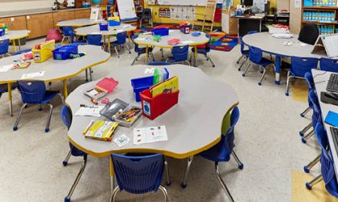
Conversations - Classroom Layout
Seating plans
Re-arranging students is important to build different relationships within the classroom.
Changing this up often is key.
Teachers may also put students together or a part for a reason.
Carpet time
Carpet time is also a good way to give students the opportunity to connect and work as a class.
Special helpers is often used in primary grades as well. Special helpers get responsibilities others do not have on that day.
They also get to pick “secret walkers”, who if picked, recieve a responsibility for being quiet in the hallway. These little practies help create class expectations.
Expectations help with behaviours in classrooms, knowing what is expected and appropriate behaviour helps overall positive behaviours.
Notes:
My mentor teacher changes up her seating plan every two weeks. She says that this helps promote other relationships that may not have formed already. Allowing students to connect with others as a group while doing activities is super helpful to their learning as they get to share, question, and connect with each others different perspectives.
https://blog.schoolspecialty.com/carroll-bell-elementary-case-study/carroll-bell-elementary-classroom-tables-chairs/

Slide 7
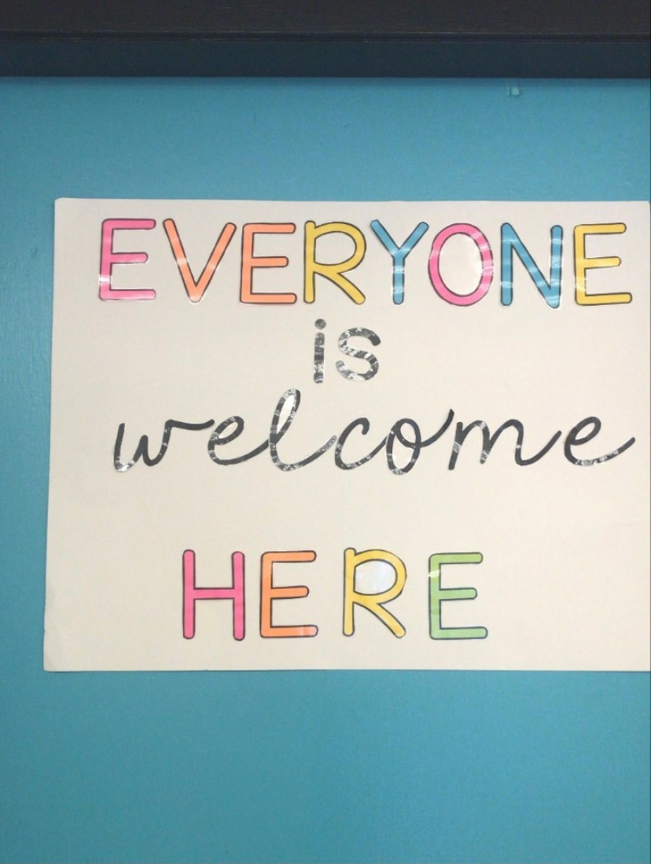
Classroom Layout Continued
Bulletin boards
During my conversations I discovered bulletin boards are also used to promote a positive atmosphere.
For example: some may look like the photo shown.
Some may also have family photos around the room to promote relationships.
or
“ All About Me” boards.
Anything making the classroom more personal and a connection to the students is key to a positive and supportive layout.
Notes:
Within all of my conversations they all had this in common. The environment of the classroom being positive, and connections to the children is very important to make sure they are feeling safe and comfortable. Positive bulletin boards, boards that connect to children such as their family, all about me boards, allows children to connect on a more personal as these are posted around the room for everyone to look at.

Slide 8
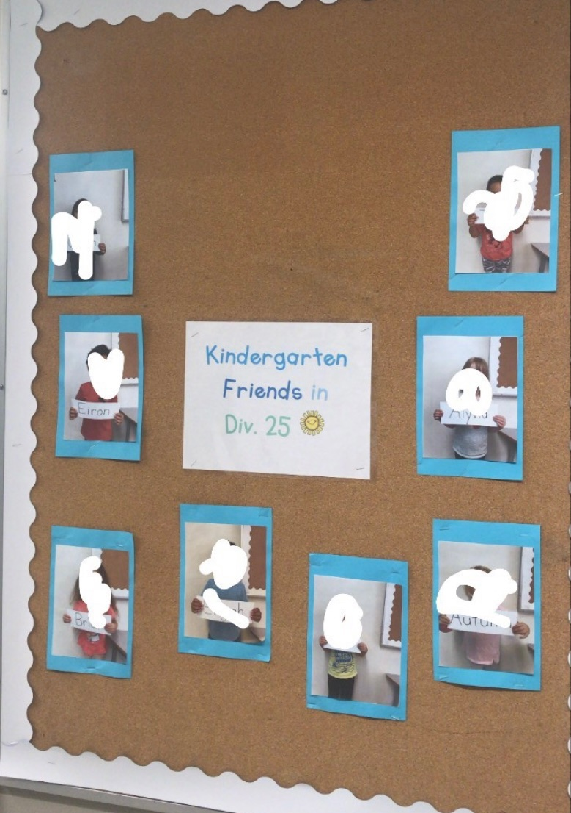
Conversations; Promoting Relationships Through Activities
Teachers ensure this is being implemented in the curriculum by reading positive texts, creating activities and classwork to promote friendships and connections.
Some of these activities may include:
Name Games
All About Me projects
Time within the day to play and socialize
Morning meetings
Friendship unit

Slide 9
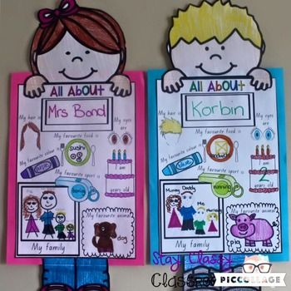
Activities Continued
All About Me Projects
All about me projects are used frequently in primary grades. This is a good way to connect the students and get to know each other.
This could include a mystery bag, using items from home. The students get to explain what the object means to them inside the bag to the class.
This could also be a bulletin board on their interests, personality, and goals.
Notes:
https://www.pinterest.ca/pin/419116309071472066/

Slide 10
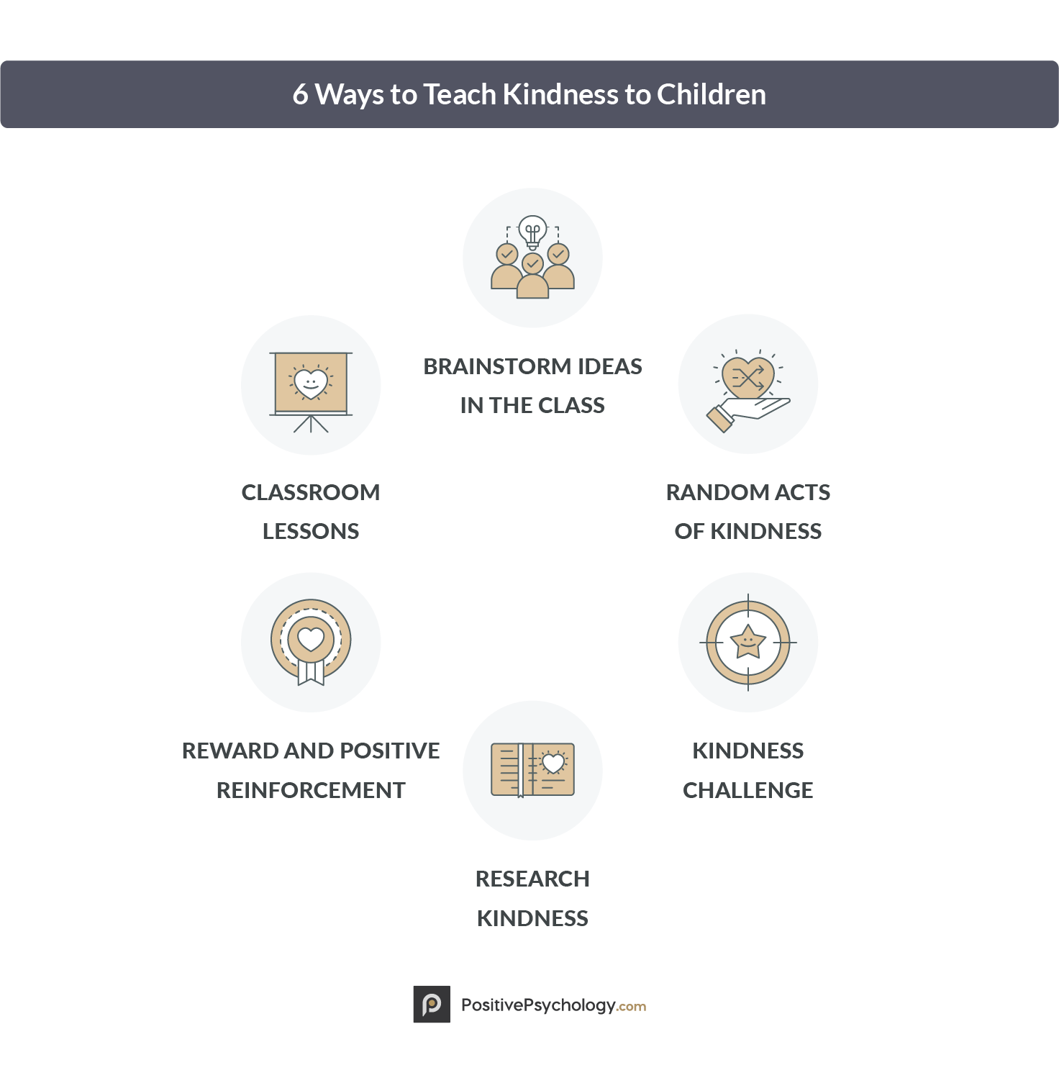
Activities Continued
Friendship Unit
WIthin my conversations, one of the teachers does a Friendship Unit at the beginning of the year. This includes:
Reading mentor texts that are promoting kindness and friendship. Doing a unit on this enlightens students to reflect on what that may look like.
Could include...
Kindness Calendars
Emotion Units
Conflict solving
Notes:
I thought this was very interesting to my teaching career. I believe reading texts and doing lessons on friendship, kindness, and emotions is very important. This could be done through providing strategies to fix problems, and positive reinforcement is one of the big ones I found in my research. The teachers from my conversations have expressed that providing techniques for students to problem solve is super important, and not stepping in too soon to give them the independence to fix their problems and work through them together. This gives students a sense of independence and confidence whenever a conflict may come up. Brainstorming as a group is also important for similar problems in the classroom to be solved in the future with these techniques.
https://positivepsychology.com/kindness-activities-empathy-worksheets/

Slide 11
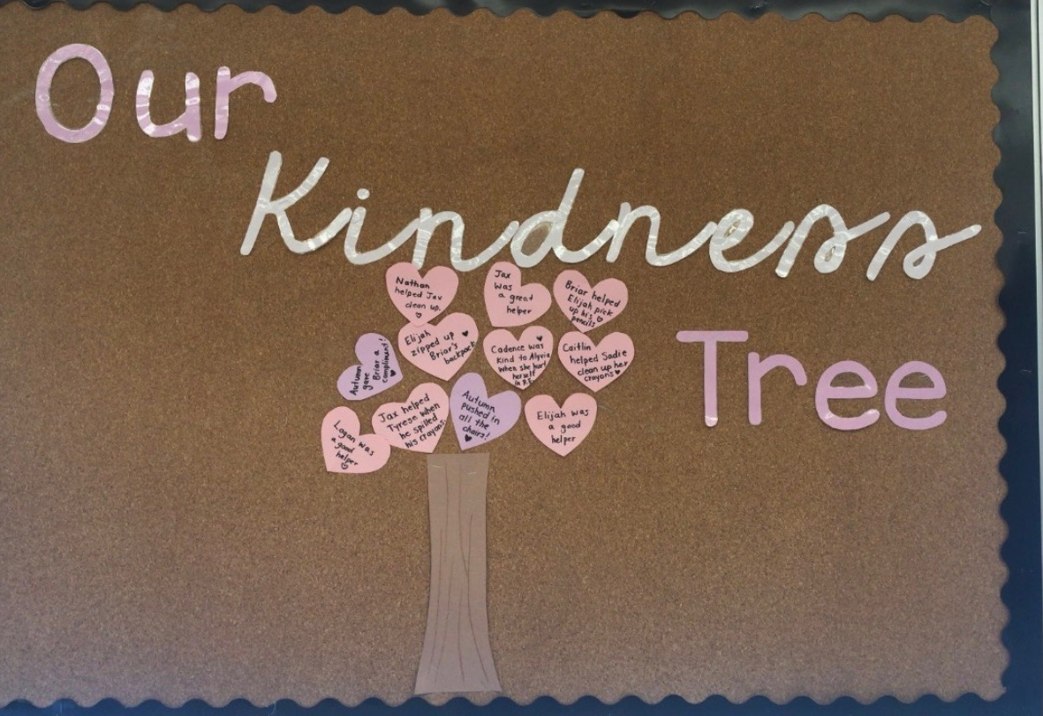
Positive Reflecting
Along with bulletin boards, many classrooms I have been in and from my conversations talked about the “teaching moments”.
This may be when a child is being kind, being helpful and generous.
This is sometimes done within the bulletin board concept, like a Kindness Tree.
A student may get praised for being kind or helpful, and is added to this kindness tree. This promotes positive behaviour in the classroom and within their relationships.

Slide 12
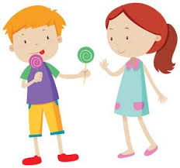
How my thinking has developed over the term
Teachers have a role in how their students interact. If a teacher is kind, students see this and naturally go towards the same mannerisms.
I also developed an understanding of how to do this in my classroom one day.
Notes:
When I started this project, I assumed that teachers would simply just do activities for children to get to know each other and games to promote this. I had no idea that the environment would be so important, and modeling by the teacher would be so important. I also did not know how important it was for students to feel comfortable in the environment to comfortably learn and connect with each other. This is very important for students learning to be able to talk about their learnings and perspectives and grow on their own by collaborating in the classroom. If there are no connections and negative ones, learning will come much harder for students who dont feel comfortable to share their ideas. I also did not think that there would be so much research done on this topic.

Slide 13
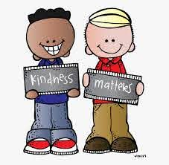
How My Inquiry is Relevant To My Future Teaching
I have learned more about classroom management through my inquiry.
I learned setting up and providing classroom expectations early on is important to classroom management and relationships.
I learned that teachable moments are extremely important to point out within the classroom, good or bad.
There are always going to be conflict in the classroom; the key is setting up the students for success in solving them.

Slide 14
Things I Will Explore More..
Throughout my teaching career, I intend to explore more ways I can intertwine teaching lessons that influence students to be kind, generous, helpful, and empathetic people.
I intend to incorporate this into my teachings, as I believe if students are in a positive environment within healthy relationships, learning will come more naturally and more meaningful.

Slide 15
References
Ellis, S. (. t., & Tod, J. (2018). Behaviour for learning: Promoting positive relationships in the classroom (2nd ed.). Abingdon, Oxon: Routledge.
Johnson, D. W. (1981). Student-student interaction: The neglected variable in education. Educational researcher, 10(1), 5-10
Jennings, P. A., & Greenberg, M. T. (2009). The prosocial classroom: Teacher social and emotional competence in relation to student and classroom outcomes. Review of educational research, 79(1), 491-525.
Scherzinger, M., Scherzinger, M., Wettstein, A., & Wettstein, A. (2019). Classroom disruptions, the teacher–student relationship and classroom management from the perspective of teachers, students and external observers: A multimethod approach. Learning Environments Research, 22(1), 101-116. doi:10.1007/s10984-018-9269-x
Webb, N. M. (2009). The teacher's role in promoting collaborative dialogue in the classroom. British Journal of Educational Psychology, 79(1), 1-28.
.

